Slide 1

Sponsor Presentation from Mike Faith

Slide 2
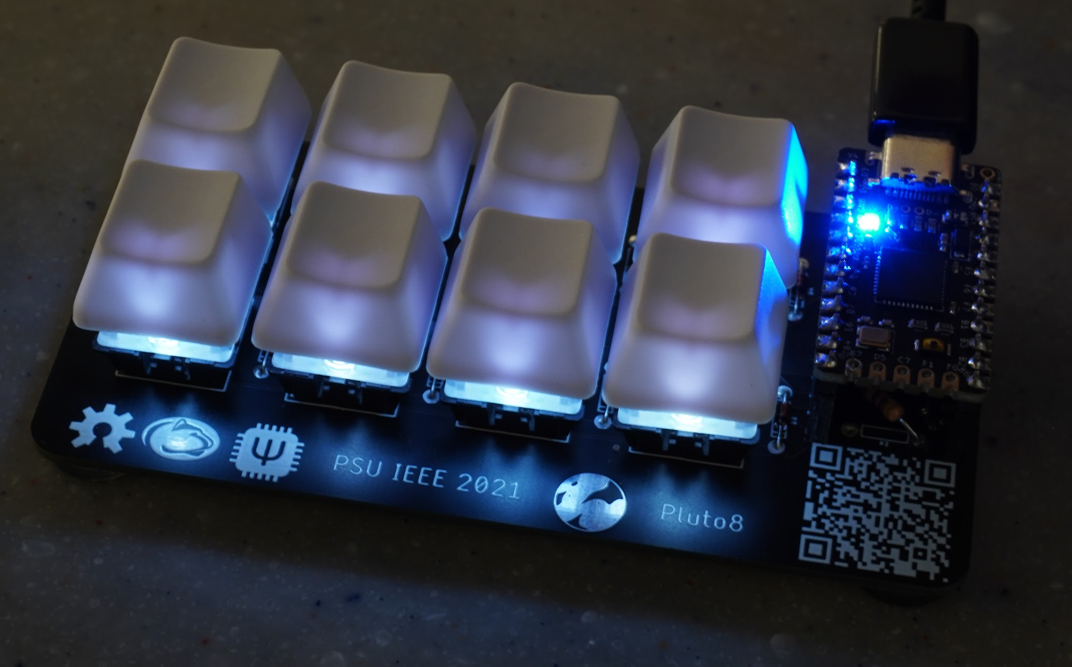
DIY Macropad Workshop
Led by Ethan Tabler and Will McGloughlin
PSU IEEE 2021
Sponsor presentation from Rohde and Schwarz

Slide 3
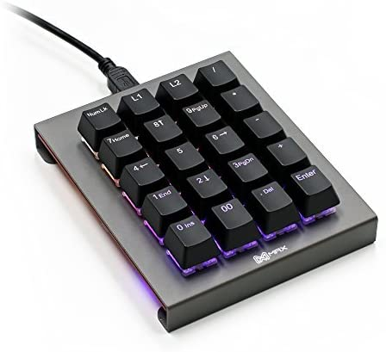
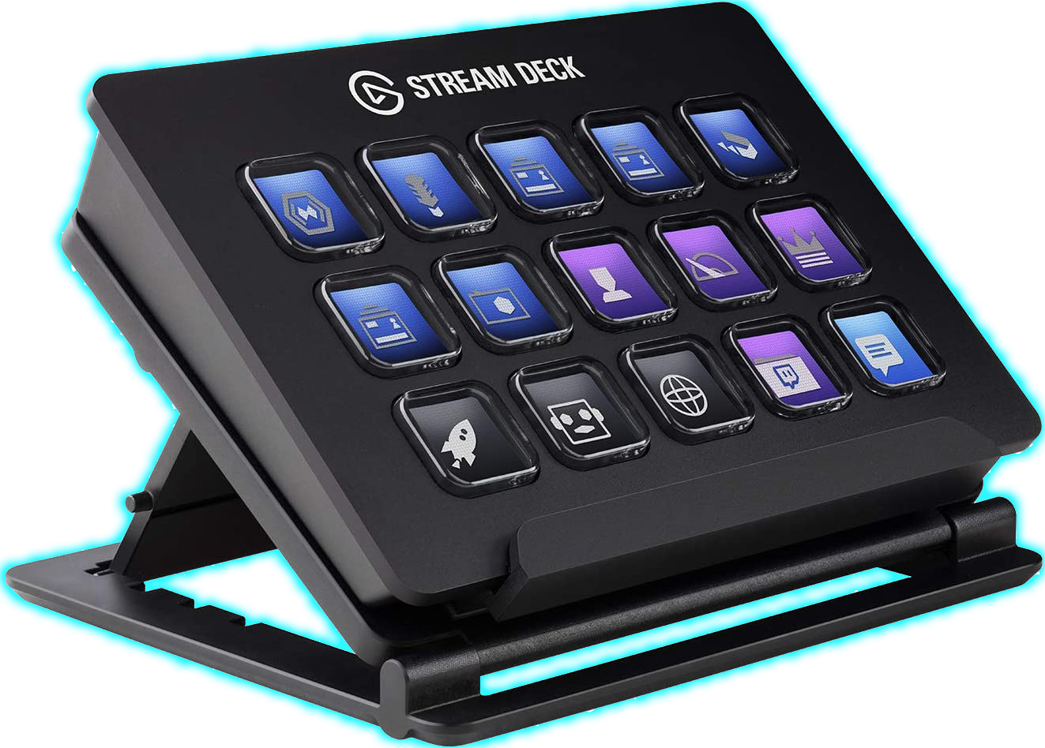
Intro to Macropads
What is a macropad
Potential uses
What do other macropads look like

Slide 4
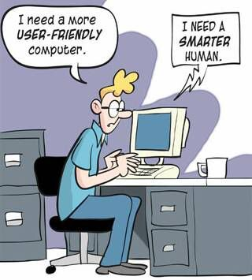
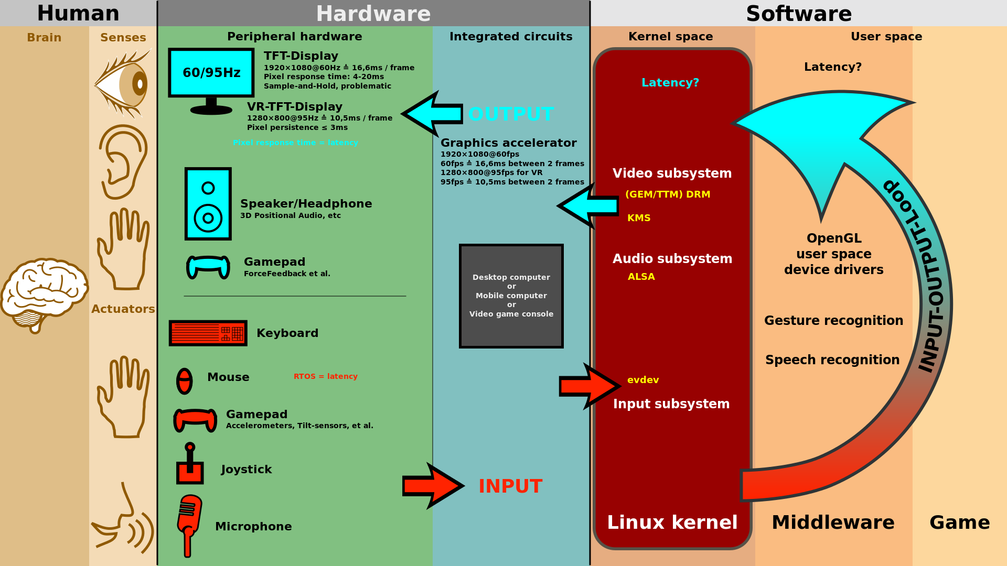
Interfacing with PCs
Pro Micro
Made by SparkFun
Most widely available board in the Arduino ecosystem with HID support
Can send mouse and keystrokes

Slide 5
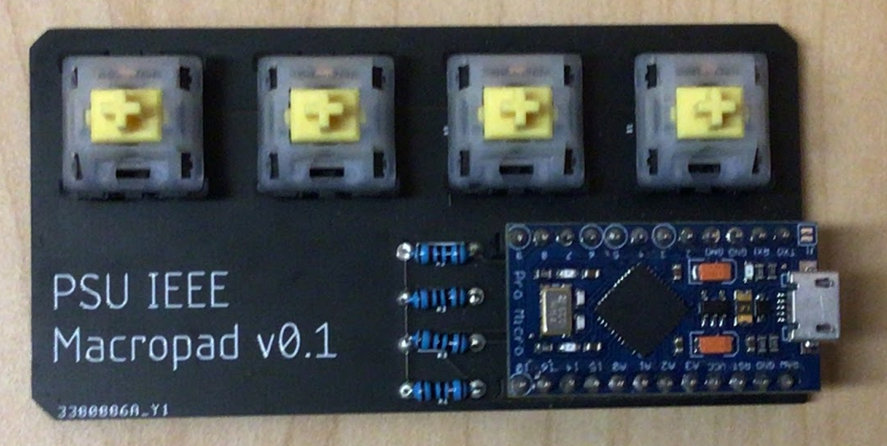
Original Prototype
4 buttons hooked up to an Arduino Pro Micro
Macros were programmed into the board using the Arduino IDE
Issues
Harder to program macros
Somewhat limited in scope of macros
QMK was a much better solution

Slide 6
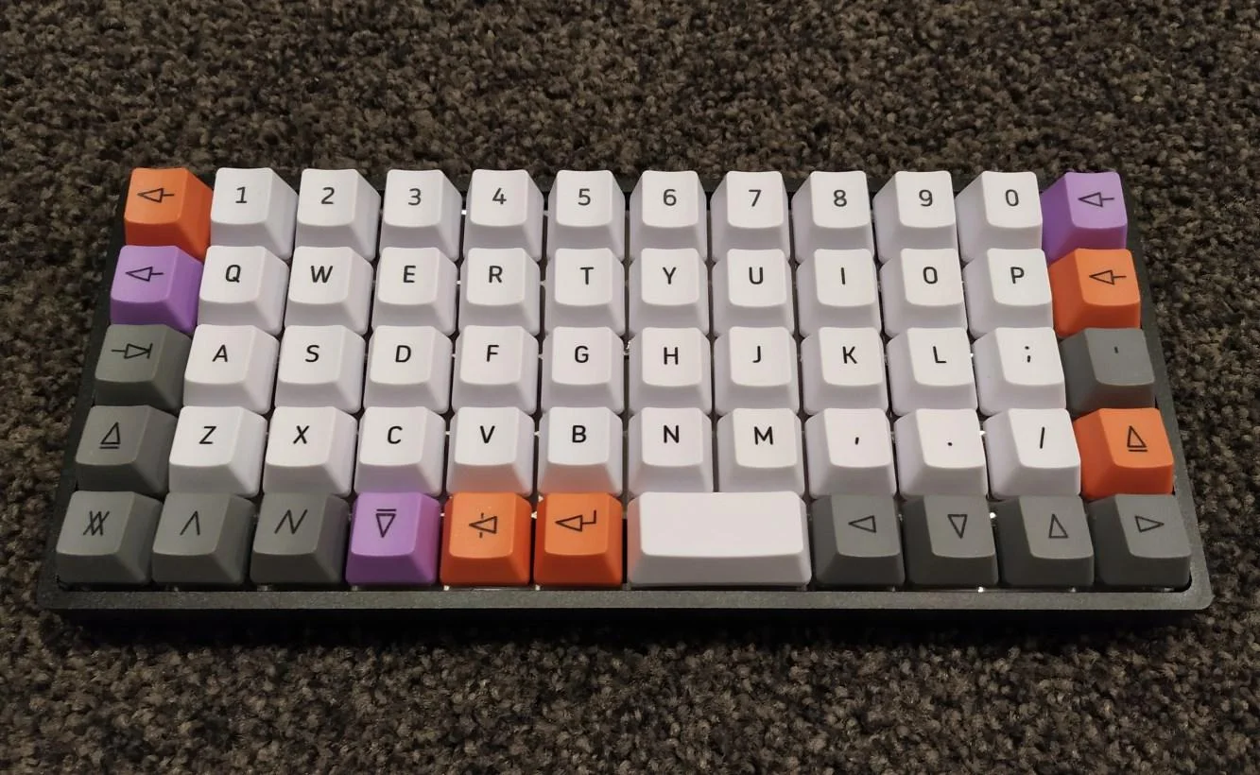
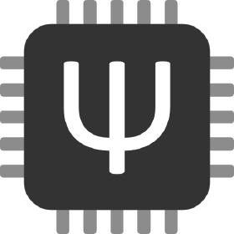
QMK
What is QMK?
What can you do with it?
How do commercial boards use QMK?

Slide 7
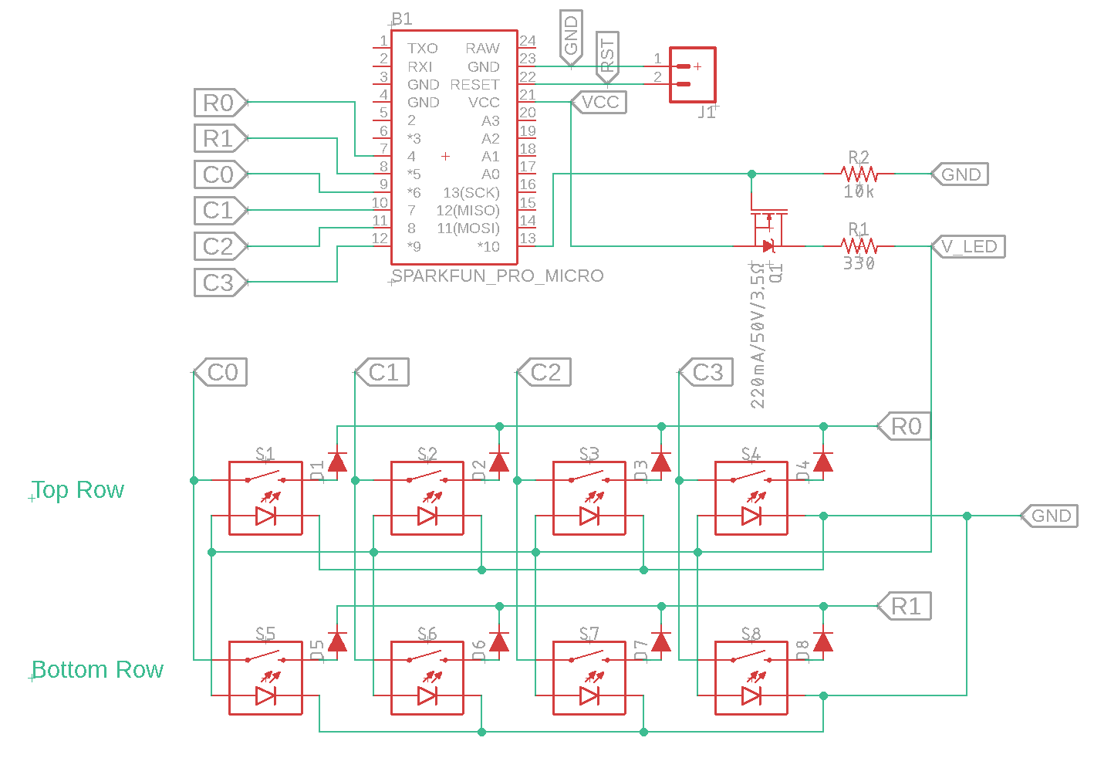
QMK circuit design
What does the circuit need in order to be QMK compatible
Matrix of keyswitches and diodes
Need to tell QMK which pins on pro micro correspond to each row and column of the matrix
In our setup, we do this with the online firmware builder
Lights(Optional)
Numlock
Backlight
Underglow
etc.
Notes:
Ethan

Slide 8
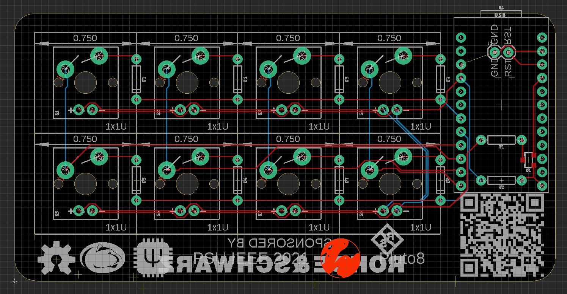

Slide 9
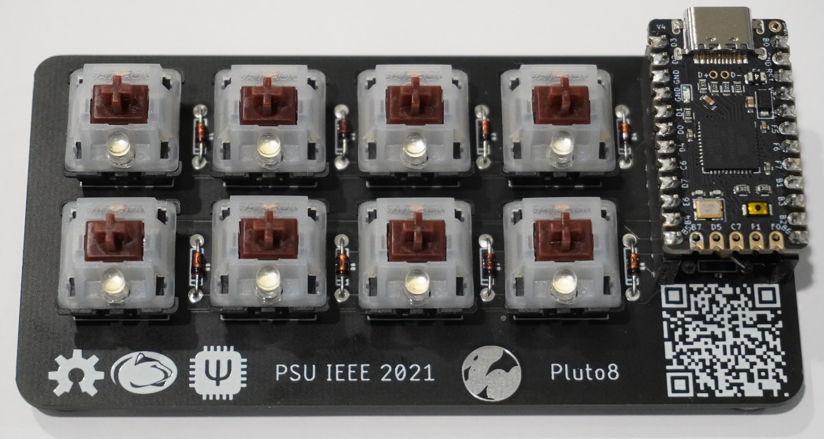
Our design
2x4 switch matrix
Custom key mapping and pin setup (see gist)
Firmware made with online tools
Layout for QMK
Make firmware from that layout
Program pro micro like normal
See also: Elite-C
Different keyswitches
Brown vs Yellow

Slide 10
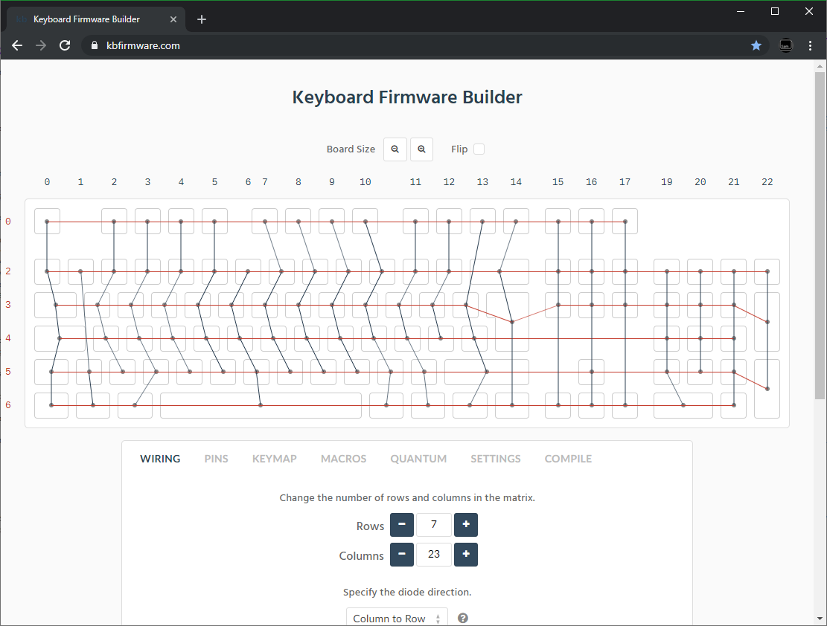

Slide 11
Our design
2x4 switch matrix
Custom key mapping and pin setup (see gist)
Firmware made with online tools
Layout for QMK
Make firmware from that layout
Program pro micro with QMK Toolkit
See also: Elite-C
Different keyswitches
Brown vs Yellow

Slide 12
Assembly
Notes:
Assembly

Slide 13
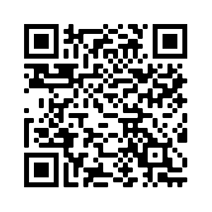
Flashing

